Slide 1
Using EEG in hypnotherapy
Dr Rachel Gillibrand

Slide 2
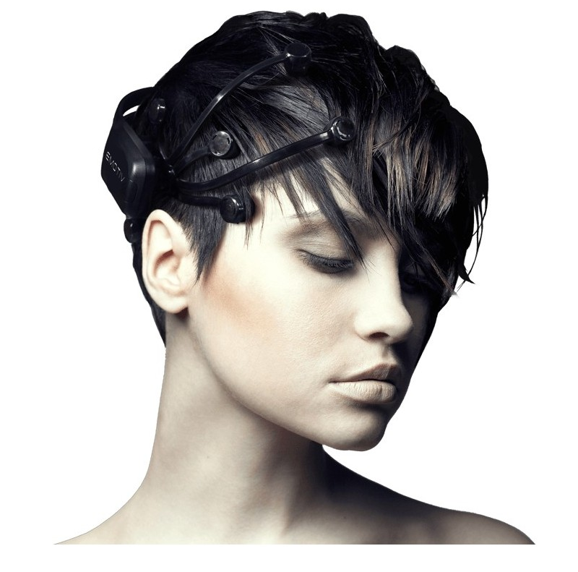
What is EEG?
a method of recording electrical energy in the brain
Electrodes are placed on the scalp and fluctuations in electrical energy are recorded usually on a graph
EEG can be used in a clinical setting to diagnose abnormal patterns of electrical activity in the brain (e.g. epilepsy)
or in a research setting to understand which parts of the brain are responsible for what sorts of activity – language, movement, memory, visual processing and so on.

Slide 3
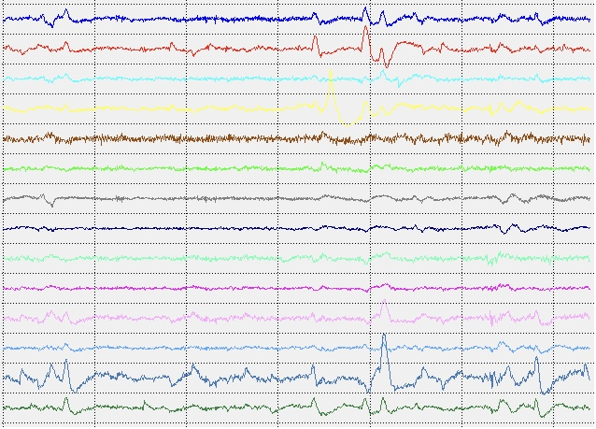
Pure EEG trace

Slide 4
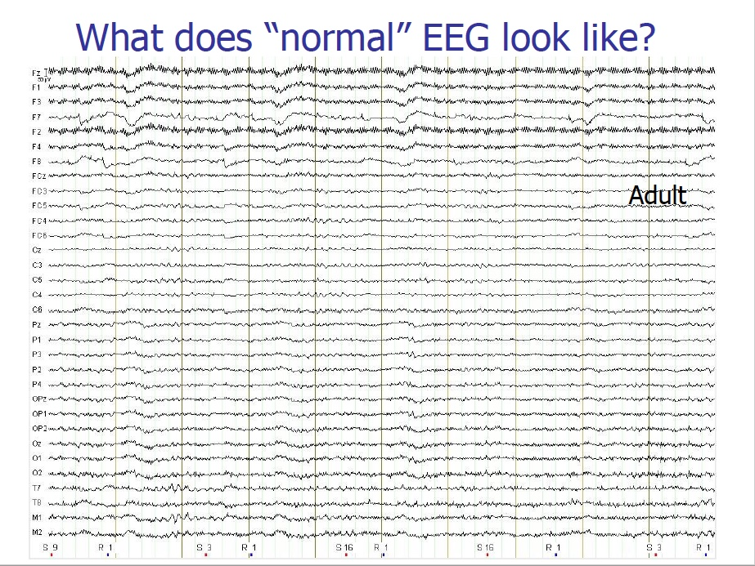

Slide 5
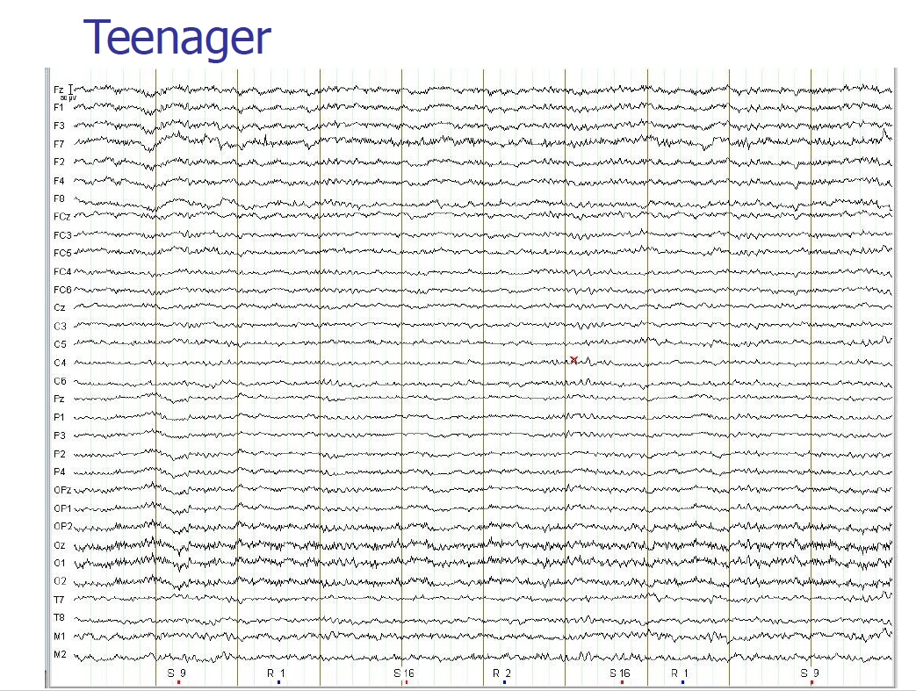

Slide 6
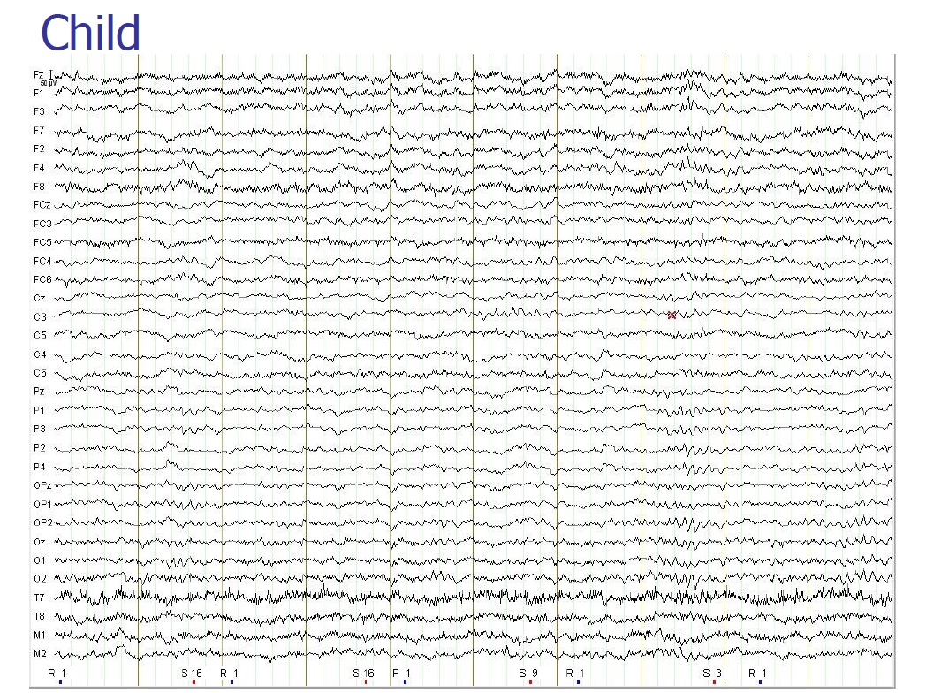

Slide 7
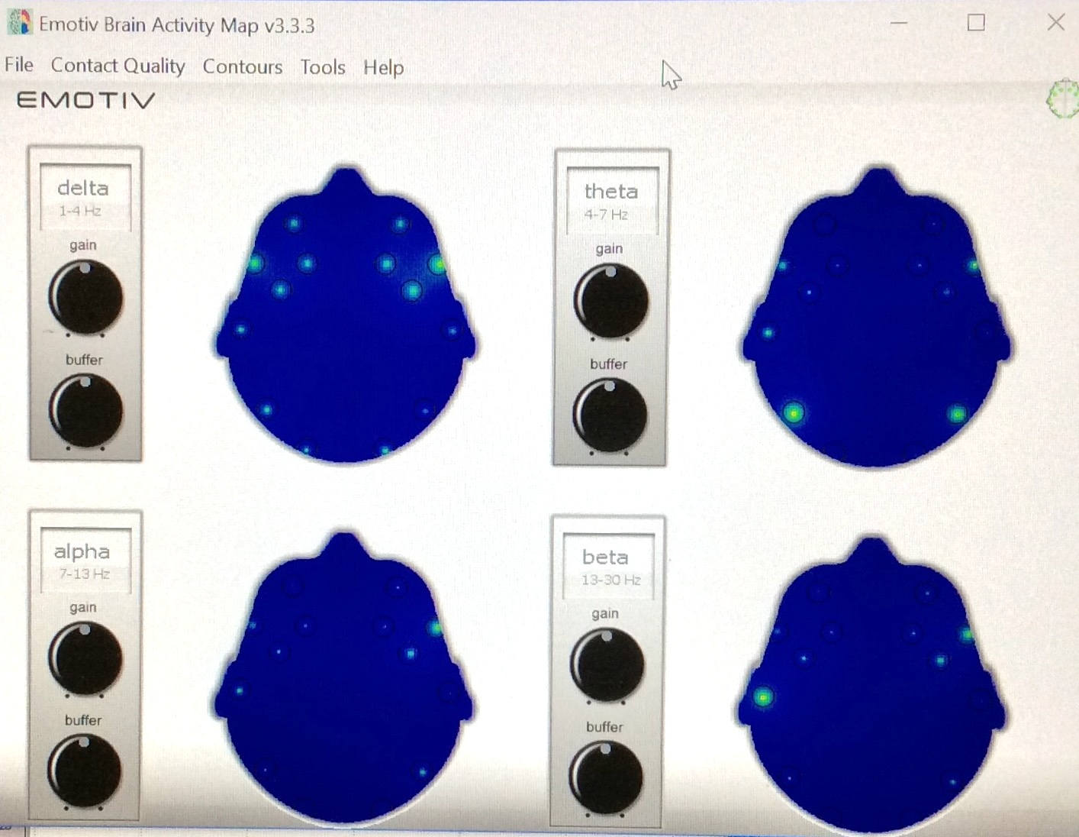
Brain waves during trance
Hop on the couch!

Slide 8
Really relaxed brain, nice delta

Slide 9
Brain waves during trance
Relaxation phase
Theta and Delta are active
Note LHS processing
Alpha is busy visualizing the material
Brain trying to make sense of it

Slide 10
Thinking about an intellectual problem/challenge

Slide 11
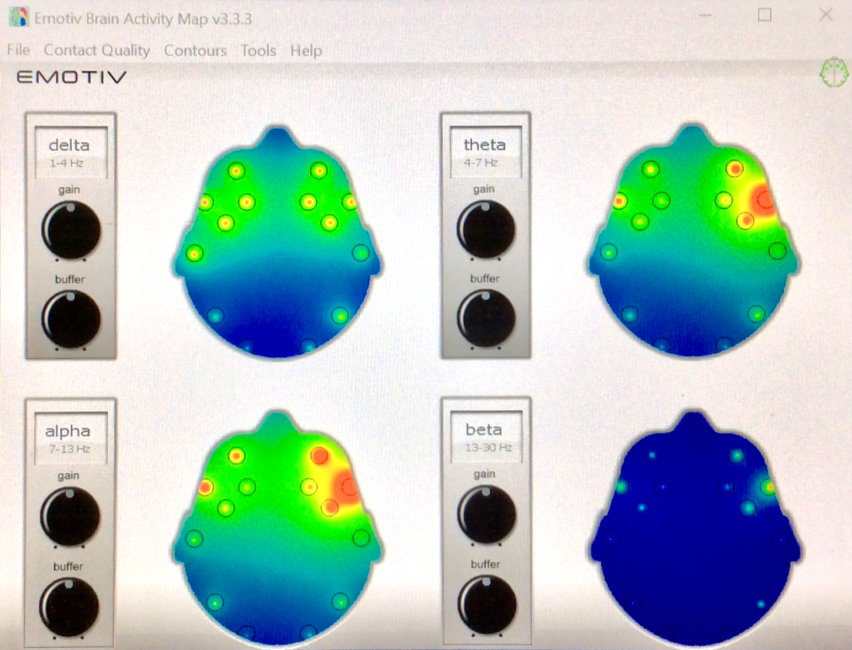
Brain waves during trance
Metaphor
Note RHS activity
High levels of visualization
Creativity
Finding solutions
Reassembling information

Slide 12
Hypnosis is good for you!
Increased Alpha:
Relaxation; enhanced problem solving; reduced fear, tension and stress; natural antidepressant
Increased Theta:
Stronger, more natural emotions; intuition; advanced problem solving; “re-programming”
Increased Delta:
Empathy; reduces cortisol, adrenalin; increases natural repair cycle; increases melatonin = sleep
Decreased Beta:
Reduced anxiety and nervousness; fewer knee-jerk reactions; controlled social interactions

