Slide 1
Neuroscience and obesity
“People may very well choose to trade off years of their life, or the possibility of disease or injury, in exchange for the current pleasure, excitement, or stress relief they get from food” Jacob Sullum.

Slide 2
Access to notes online
On CPHT website:
www.cpht.co.uk – Student/Practitioner – CPD – CPD Handouts (left hand panel on CPD page)
You can also download your Attendance Certificate
C59Bp63t

Slide 3
What are your objectives?

Slide 4
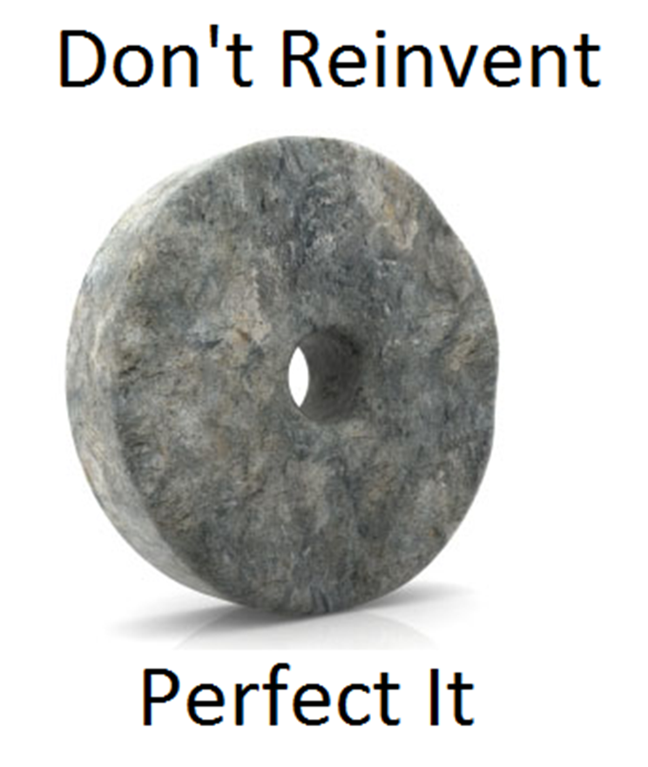

Slide 5
OVERVIEW
Biological factors
Evolutionary perspective
Psychological factors
Treatments
SFH
How to integrate knowledge into sessions

Slide 6
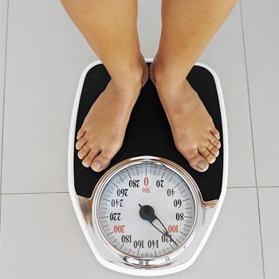
Overweight and obesity are terms that refer to an excess of body fat and they usually relate to increased weight-for-height.
The more obese the higher the
risk of disease
Measured by examining BMI &
body fat (adipose tissue)

Slide 7
BMI - Body mass index
- Calculated by dividing weight by square of height
19-24 ideal weight
25-29 overweight
30-39 obese
40-54 morbidly obese
BMI correlates reasonably well with laboratory-based measures of adiposity and is extremely practical in most clinical settings (Zhu et al 2002)
Limitations of BMI

Slide 8
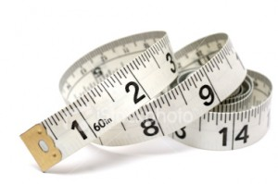
Waist circumference
Abdominal fat has a direct influence on health with greater health risks than adipose tissue in other regions of the body (Wang 2003).
Risk of heart disease and type 2 diabetes increases if waist is >35 inches (88cm) for women or >40 inches (101cm) for men.
Women, low waist circumference is <80cm,
high as 80-88cm and
very high >88cm
Men, low waist circumference is defined <94cm,
high as 94-102cm and
very high >102cm.

Slide 9
In November 2014, NICE published guidance on the identification, assessment and management of overweight and obesity in children, young people and adults
The guidance included a recommendation for health professionals to ‘think about using waist circumference, in addition to BMI, in people with a BMI less than 35kg/m2 ’. For adults with a BMI of 35kg/m2 or more, risks are assumed to be very high with any waist circumference.

Slide 10
Health outcomes
Obesity and central obesity is linked with increased risk of hypertension, longstanding illness and mental ill health. For example, obese adults had about twice the prevalence of hypertension compared with adults who were neither obese nor overweight
Combining obesity and waist circumference the findings showed that 34% of men and 43% of women were at high or very high risk of obesity-related chronic disease.

Slide 11
HEALTH OUTCOMES
Uncontrolled cellular Inflammation (cardiovascular disease, arthritis, cancer, diabetes)
Hypertension (high blood pressure)
Hyperlipidaemia (high levels of fats in the blood that can lead to narrowing and blockages of blood vessels)
Gall stones
Arthritis
Infertility/Pregnancy complications – neural tube defects, pre-eclampsia, perinatal mortality
Depression/anxiety

Slide 12
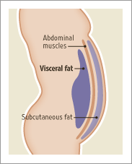
ADIPOSE TISSUE
Subcutaneous
Visceral
Main role to store lipids
Hormone producing
Reducing adipose tissue

Slide 13
Obese adipose tissue is characterised by inflammation and progressive infiltration by macrophages as obesity develops (Wellen 2003)
Exess fat in cells is toxic and causes cell damage

Slide 14
INSULIN
Main role is to manage circulating concentrations of nutrients (glucose & fat)and keep them in a narrow range
Kloting et al 2010 – visceral fat, macrophage infiltration, enlarged fat cells are associated with insulin resistance
Insulin resistance – occurs when insulin too high for too long causing a decrease in sensitivity to the hormone – leading to decreased ability to deal with glucose and fat

Slide 15
SATIETY i.e fullness
The consumption of food during meals is governed by mechanisms that act over short time intervals to control the initiation and termination of food ingestion.
Initiation – sensitive to time of day/food availability etc
Meal termination – driven by bio factors
Perception of satiety – gastric distension and CCK
Several observations suggest that leptin (a protein hormone) reduces food intake by heightening the response to meal-related satiety signals.
Morton et al (2005)

Slide 16
LEPTIN
Human leptin is a protein
mainly produced in adipose tissue.
It is responsible for providing
satiety signals.
It is produced proportionally to
adipose tissue.
More leptin = leptin
desensitisation
Leptin levels decrease during
fasting and low calorie diets.

Slide 17
Ghrelin
Ghrelin is secreted primarily in the lining of the stomach. Ghrelin increases hunger.
Your stomach makes ghrelin when it’s empty. Just like leptin, ghrelin goes into the blood, crosses the blood-brain barrier, and ends up at your hypothalamus, where it tells you you’re hungry
Ghrelin is high before you eat and low after you eat.
When a person loses weight their ghrelin levels increase, which causes increased food consumption and weight gain. On the other hand, when a person gains weight, ghrelin levels drop, leading to a decrease in food consumption and weight loss. This suggests that ghrelin acts as a body weight regulator

Slide 18
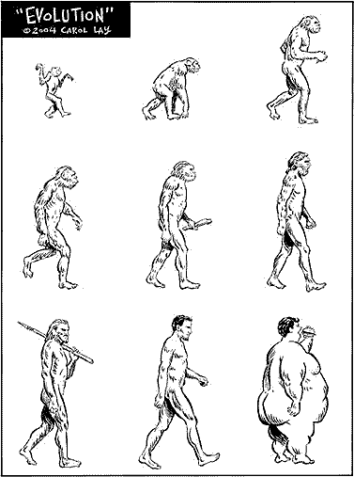
The prevailing approach to treat obesity follows precisely the laws of nature:
exercise more and eat less (Bruemmer 2012) however with more than 1 billion adults worldwide classified as obese, this chronic problem seems resistant to treatment.

Slide 19
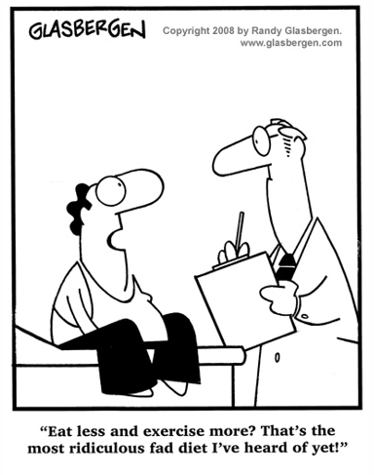
DIETS
Many fad diets, atkins etc
What really works?

Slide 20
Fundamental errors – Dr J Fung Aetiology of Obesity
1. Proximate vs ultimate causes
Ultimate cause Proximate cause Event
(treatment useful) (treatment futile)
2. Obesity/weight gain is a two compartment problem – not simply a matter of energy in and energy out…
egThink of yourself as a manager of a coal burning power plant
Every Day you get 2000ton of coal and you burn 2000t of coal
But that’s not the only place it can go, you can store some
What’s important is not the total amount you get, it’s which way you go…

Slide 21
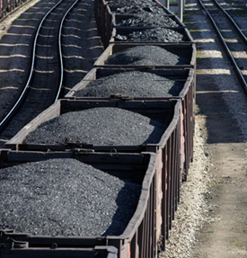
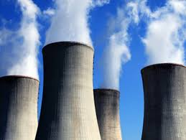
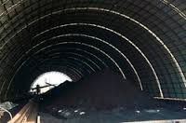
Energy In
Fat Stores
Energy Out

Slide 22
If you decrease calories, you’ll decrease calories out (metabolic rate) so you don’t use up all your fat stores
If you maintain lower weight your metabolic rate stays down
When you lose weight through calorie reduction , even 1 year after, your ghrelin (hunger hormone) is much higher than before and peptide yy (makes you feel full) is lower than normal – so you are hungrier than before so you eat more, and you are burning less energy so you put the weight back on…

Slide 23
The cruel hoax
Eat less calories
Regain weight
Lose weight
Decreased metabolism
Increased hunger

Slide 24
…if you stop moving you die. We’re all circling the drain every day of our lives; move faster and you stay farther from the hole for longer, like a marble in the sink.
Will Gadd – Ice climber

Slide 25
Eating as a pleasurable activity
Reward
Social
While food seeking is initiated by hunger it is ‘incentive motivational’ cues in environment that guide our behaviour (eg the men that made us fat)
Dopamine serves as a guiding influence

Slide 26
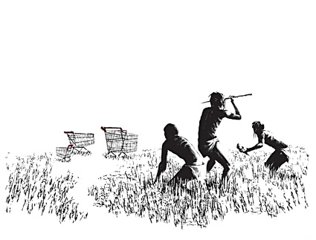
EVOLUTIONARY PRESSURES FOR PLEASURABLE EATING
“Overconsumption of palatable food is becoming a modern epidemic, we prefer to over consume sweet and high fat palatable foods” (Drewnowski 1995)
This has a primitive origin however:
Hunter gatherers
Motivation to seek food
Override satiety signals

Slide 27
EVOLUTIONARY PRESSURE TO INHIBIT EATING
Here are some examples scenarios of when feeding inhibition would have been adaptive
To conserve food during anticipated food shortages
A valuable social tool, to enable food sharing thus fostering reciprocity and ensuring fitness of ones and family and offspring
Follows social norms; to eat more than ones “fair share” would have likely have been viewed as a burden to the group
PFC mediated process

Slide 28
WANTING & LIKING
‘Liking’ refers to pleasure derived from oro-sensory stimulation of food
‘wanting’ refers to the motivation to engage in eating.
Dopamine
Delayed discounting

Slide 29
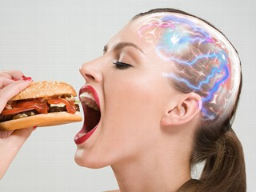
OVEREATING & DOPAMINE
Motivation to eat regulated by dopamine
Stice et al (2010) study
More we eat less pleasure we get and so on…
Recommendations for future research and treatment implications

Slide 30
Positive & Negative affect
fMRI study (Killgore & Yurgelun-Todd 2006)
- 13 normal weight women showed pictures of high & low calorie food
- From their affect (emotions, facial,vocal, gestural) scores, positive affect showed increased satiety with high calorie picture and hunger with low calorie picture & the opposite was observed for negative affect

Slide 31
CORTISOL & OBESITY
Released in response to stress
Its primary functions are to increase blood sugar, suppress the immune system and aid in fat, carbohydrate and protein metabolism
Excess cortisol and visceral fat
Cortisol affects lipid mobilisation
More adipose the more cortisol
Cortisol & insulin

Slide 32
STRESS & EATING
Stress and appetite - stress can sometimes lead to increase in food intake but mainly it leads to decreases
Threat stress – cortisol HPA
Challenge stress –SAM axis and cortisol protection
Comfort eating – cortisol stimulates hunger and feeding

Slide 33
Theoretical model of reward based stress eating (Adam & Epel 2007)

Slide 34
Sleep & Obesity
Approx 50 studies show a significant association between short sleep (<6 hrs) & increased obesity
Fatigue increases sedentary behaviour
Grehlin (hunger inducing hormone) increases with sleep restriction
Studies show increased hunger & calorie intake after 4 hrs of sleep compared to 8

Slide 35
DRUGS INDUCING OBESITY
Sulfonylureas (Type 2 Diabetes drug- increase insulin levels and thus utilisation of glucose and other metabolic fuels)
Insulin – converts sugar to glycogen, if not used stored as fat
Oestrogen – fluid retention & fat cells produce oestrogen, during fluctuations of oestrogen ie menopause fat cells increase to compensate for dropping levels of oestrogen.
Alcohol – extra calories
Steroids – affecting metabolism and how the body deposits fat
Cyproheptadine – used to treat allergies such as hay fever – appetite stimulant
Valproate – anti convulsant used to treat epilepsy, anorexia, anxiety migraine and bipolar disorder – increases insulin and appetite
Tricyclic antidepressants – e.g. Amitriptyline – affects insulin and hormones
Phenothiazine – antipsychotic e.g. Chlorpromazine – appetite increase and glucose tolerance

Slide 36
DRUGS USED TO TREAT OBESITY
Orlistat – i.e. Alli reduces fat absorption from the intestines – relatively successful, digestive side effects
Sibutramine – serotonin, dopamine and norepinephrine reuptake inhibitor – helping enhance satiety and influencing appetite – similar structurally to amphetamine but differs as it doesn't force the release of these neurotransmitters just the reuptake (appetite suppressant) – withdrawn from market
- Adverse effects: hypertension, serotonin syndrome, dry mouth, insomnia, headache, constipation, seizures, fatal pulmonary hypertension may occur.
Metformin - lowers insulin levels and limits the amount of glucose that is produced by the liver as well as increases muscle consumption of glucose. Adverse effects: Gastro-intestinal upset
Rimonabant – A cannabinoid receptor antagonist – decreases appetite - Adverse effects: severe depression and predisposes to neurodegenerative disease e.g. Alzheimer’s – newer drug but taken off the market in 2008
Source: Palatty & Saldanha (2012)
Gastric band

Slide 37
Important points
Stats
Adipose tissue
Leptin
Primitive man
Dopamine
Cortisol
Challenge vs threat stress
It’s all about reducing anxiety and increasing positivity

Slide 38
OUR ROLE AS SFH
Lowering anxiety in ones life can have a dramatic impact and alleviate many symptoms
Stradling et al (1998)
- Three groups – one hypnosis with focus on energy intake reduction, one hypnosis and stress reduction and one no hypnosis dietary advice
- All groups experience 2-3% weight loss at 3 months
- At 18 mths only the hypnosis with stress reduction achieved sig more weight loss

Slide 39
INITIAL CONSULTATION
To be conducted in the usual way but can include questions in following areas:
Health related issues
Diet/eating habits (again not to focus on but to give a good idea of what needs to change)
Exercise
Any previous attempts to lose weight what has/hasn’t worked
Hobbies interests (need to find clues to dopamine serotonin raising activities)
NB Some of this information will come out as part of the ‘how can we help you?’ question

Slide 40
OTHER SESSIONS
Proceed as normal. Scaling, miracle question, cd for home use relaxation and salient content on couch
It is common for weight loss to not be mentioned very often, similar to insomnia, once the penny has dropped the client recognises where their focus should be.

Slide 41
Exercise - Relating it to the client
Relating it to the client

Slide 42
Do hypnotic gastric bands work?
Should I weigh/measure the client?
Do you use direct suggestion with the client?
When asked the miracle question the client keeps saying ‘I will be thin’ how do I deal with this?
My client says they are not anxious they just want to lose weight…
Do I provide any dietary or exercise advice?
Any other questions?

